Slide 1
illustrations
can convey feelings and personality

Slide 2
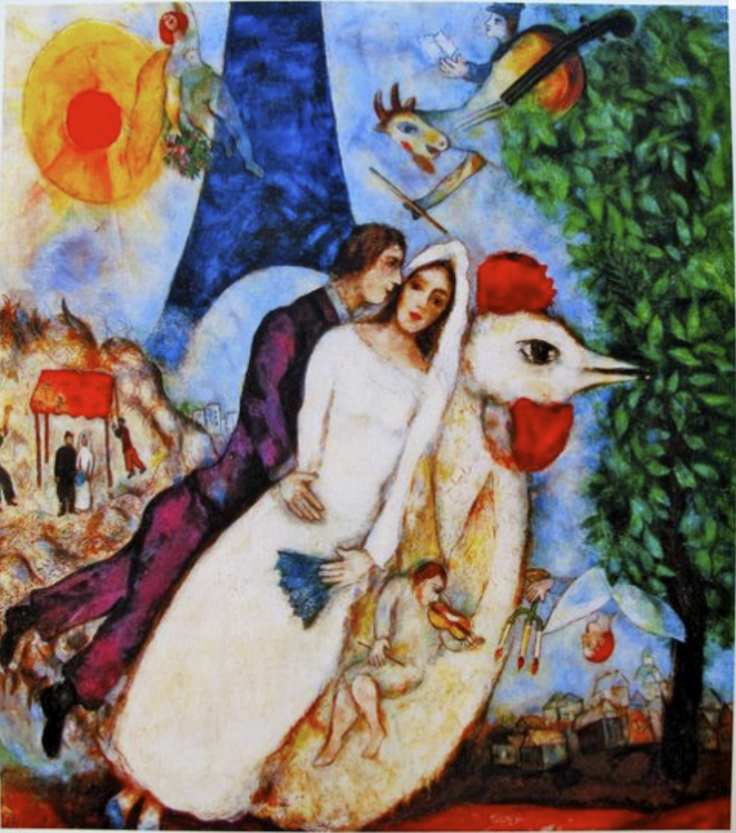
Marc
Chagall
Russia

Slide 3
illustrations
Do not need to perfectly represent an object or person.
They do not need to show everything written in words on the page

Slide 4
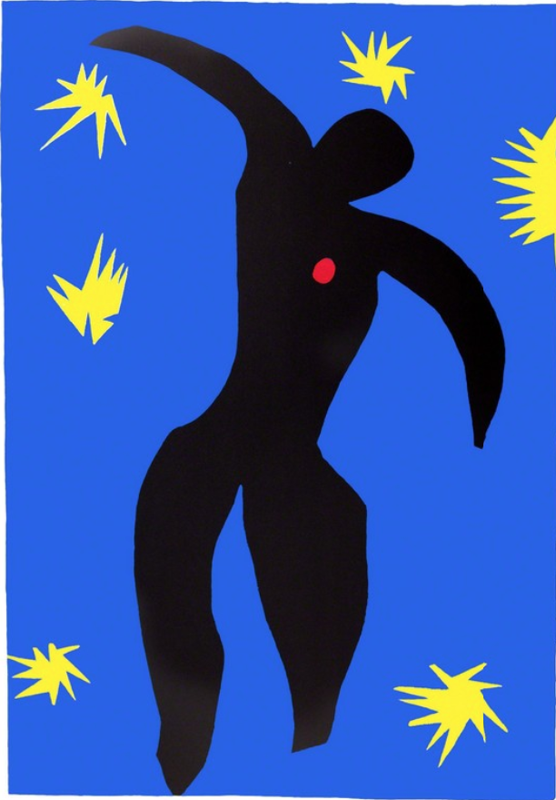
Henri
Matisse
France

Slide 5
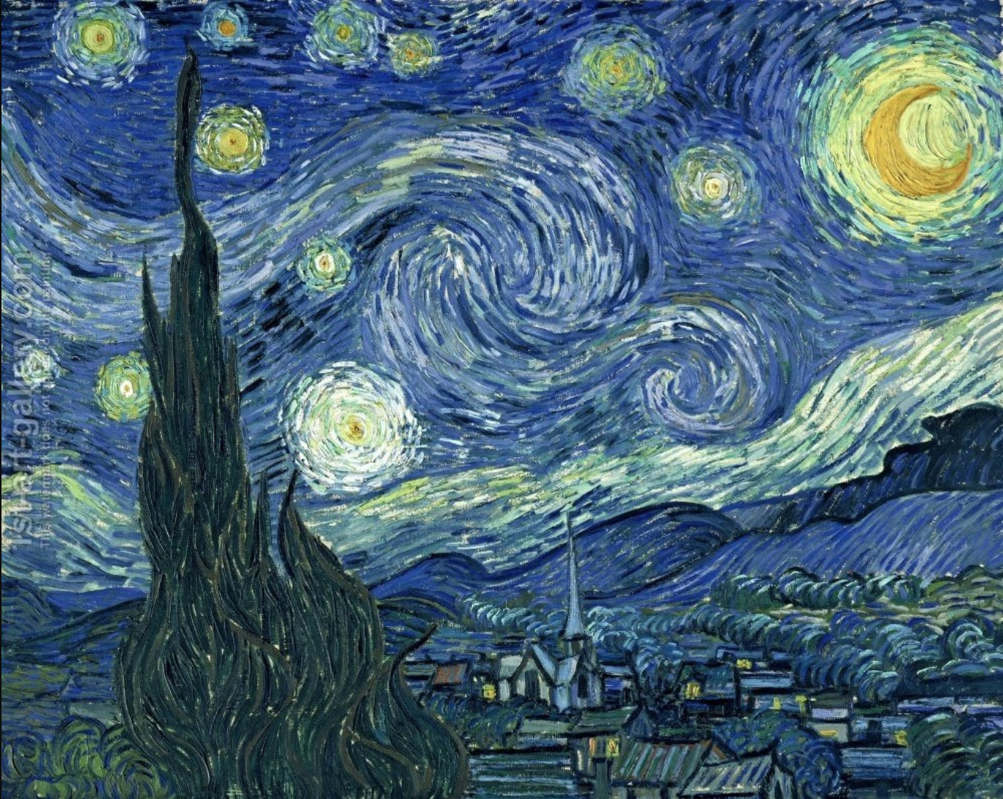
Vincent
Van Gogh
France

Slide 6
The most important thing is that your illustrations are yours and express your feelings.

Slide 7
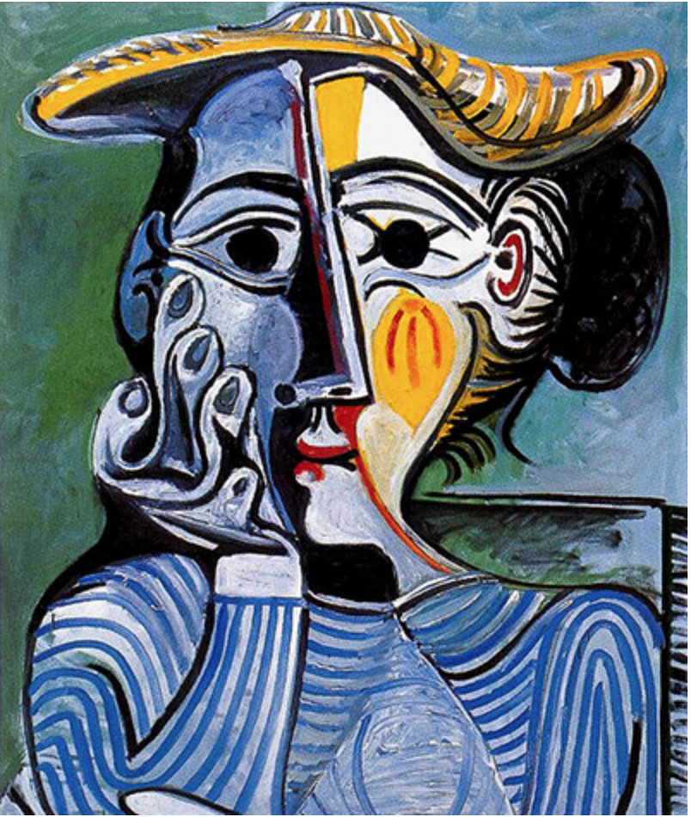
Pablo Picasso
Spain

Slide 8
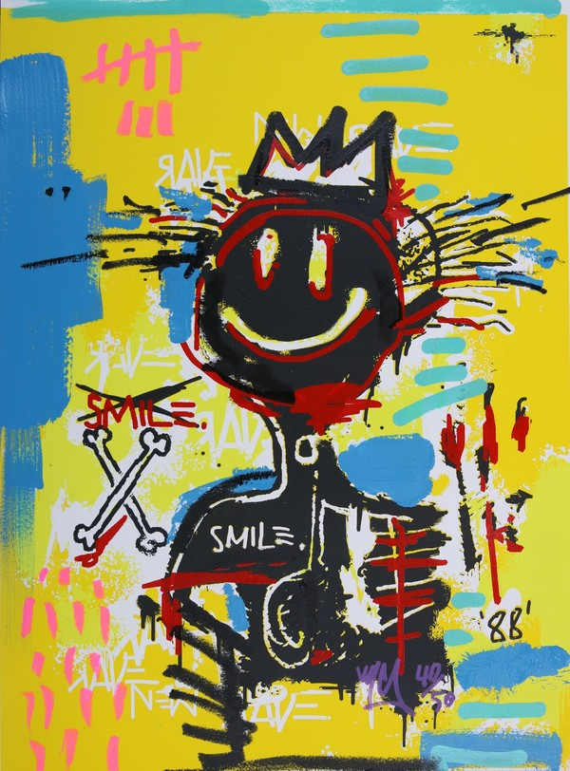
Jean-Michel
Basquiat
America

Slide 9
illustrations
can express feelings and ideas that are difficult to put into words

Slide 10
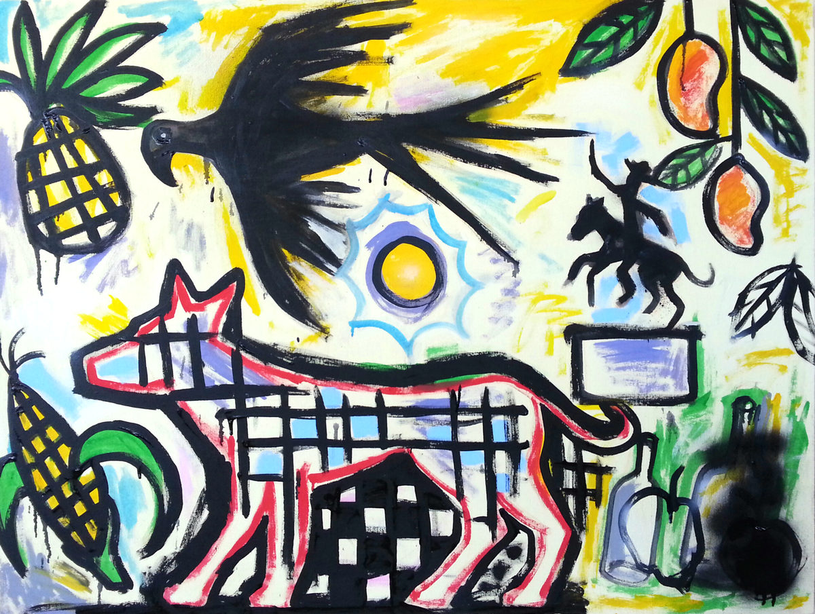
Hugo
Perez
Guatemala

Slide 11
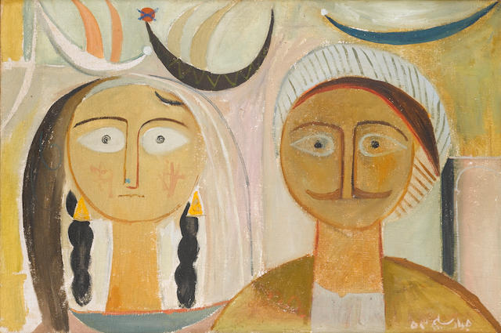
Jewad
Salim
Iraq

Slide 12
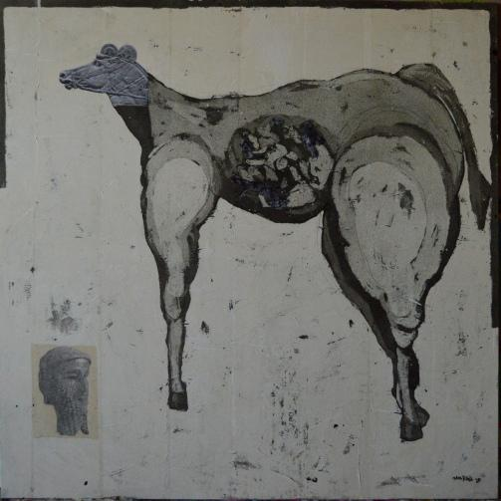
Alaa
Sharabi
Syria

Slide 13
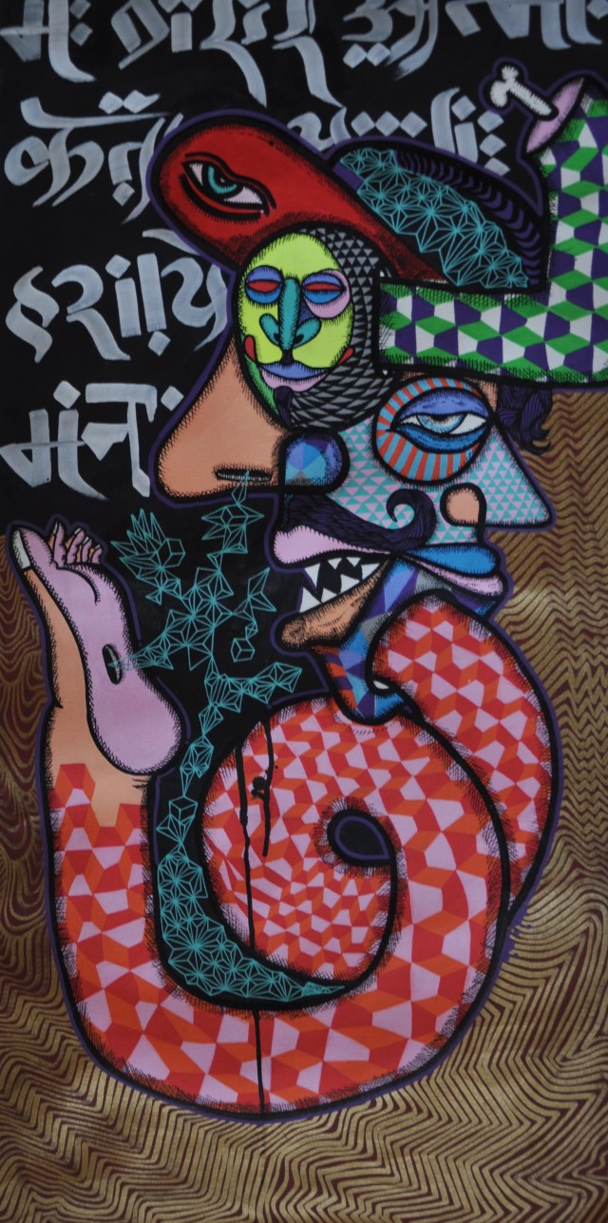
Aditya
Aryal
Nepal

Slide 14
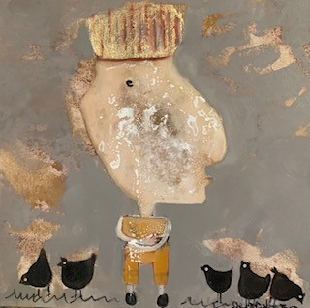
Souad
Mardem
Syria

Slide 15
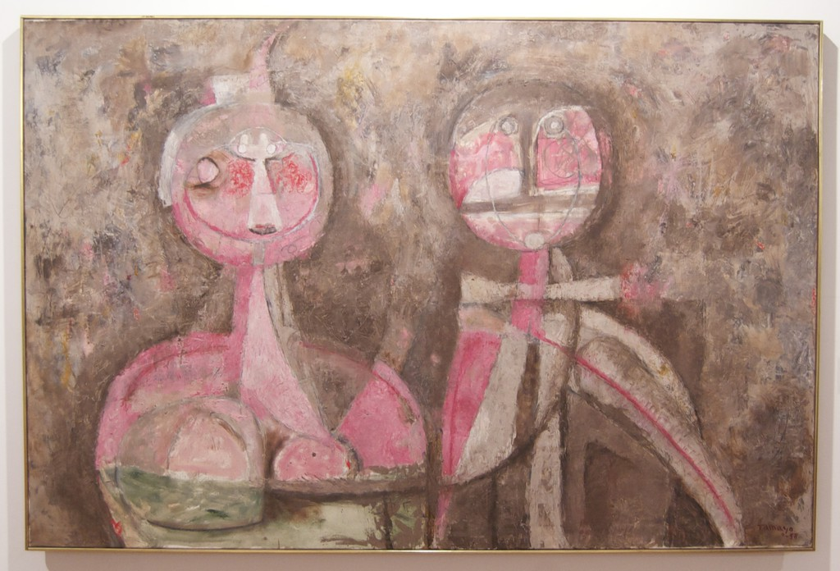
Rufino
Tamayo
Mexico

Slide 16
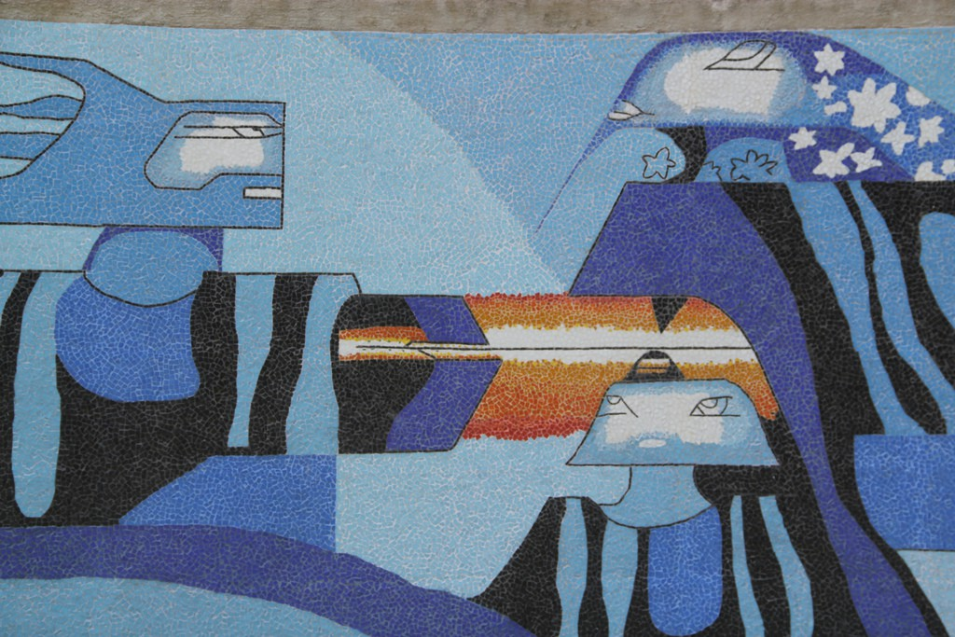
Efrain
Recinos
Guatemala

Slide 17
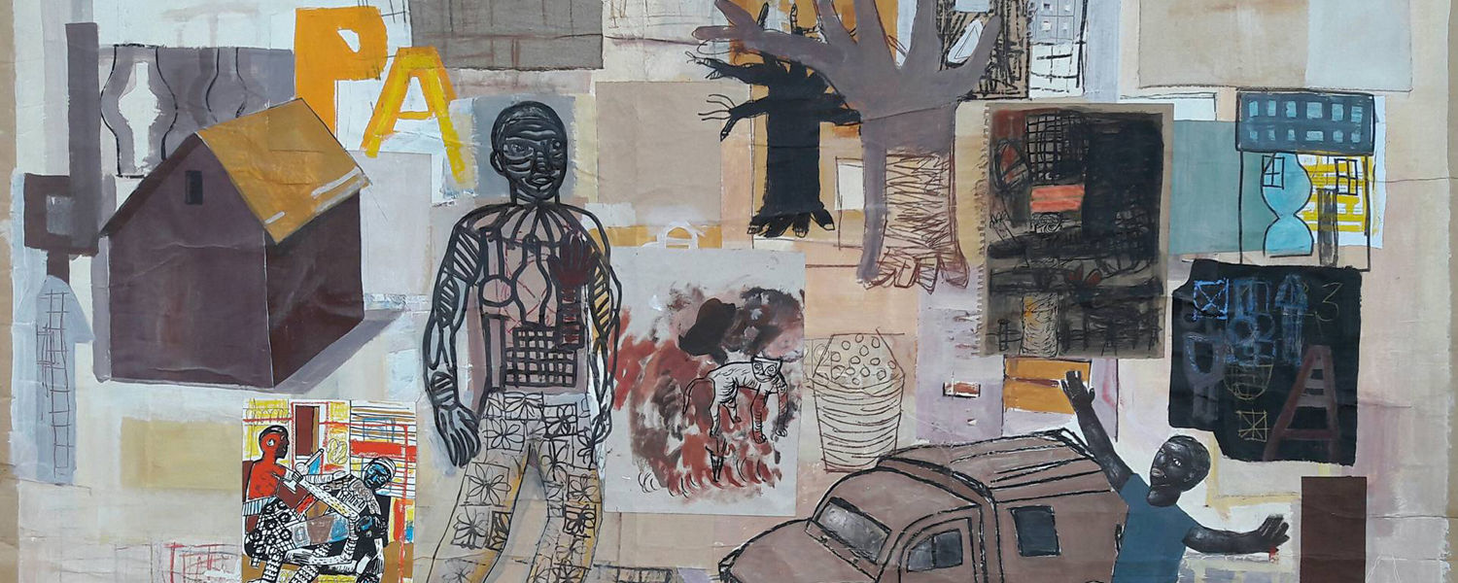
Amadou Camara Gueye Senegal

Slide 18
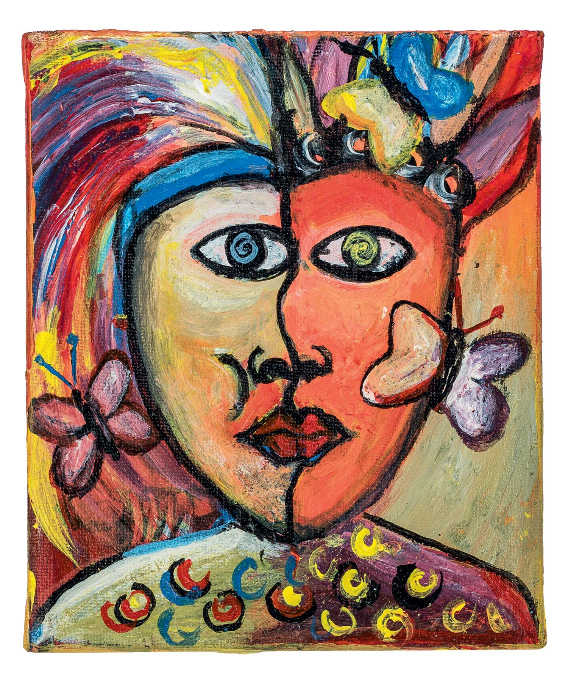
Moses
Izabiriza
Rwanda

Slide 19
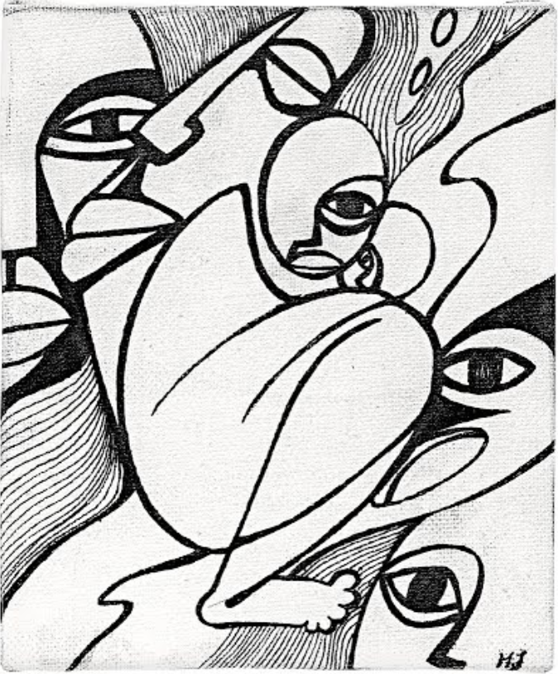
Manu Julio
Guinea

Slide 20
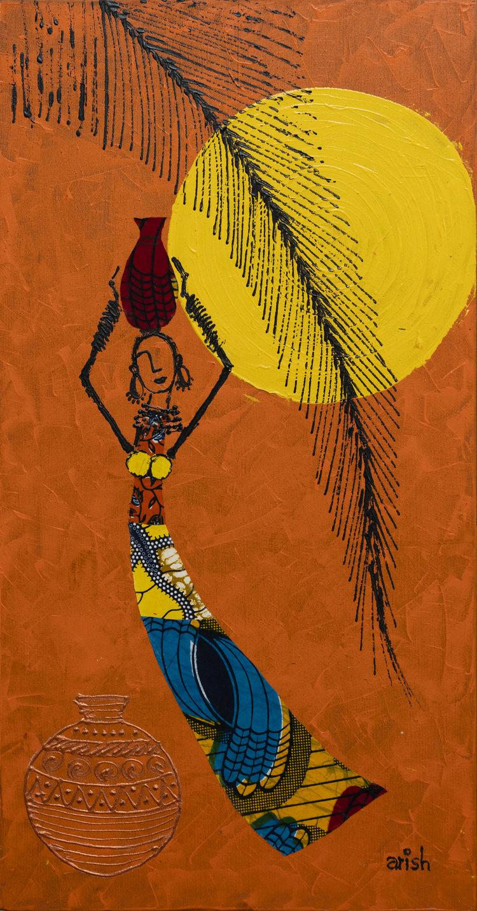
Arish
Burundi

Slide 21
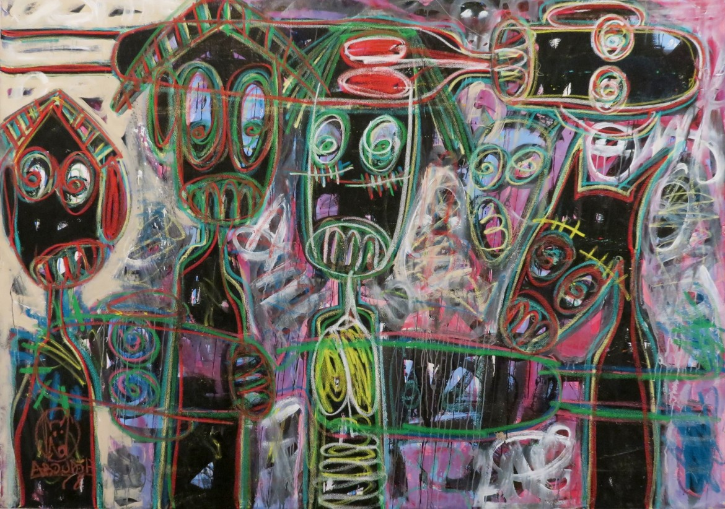
Aboudi
Ivory
Coast

Slide 22
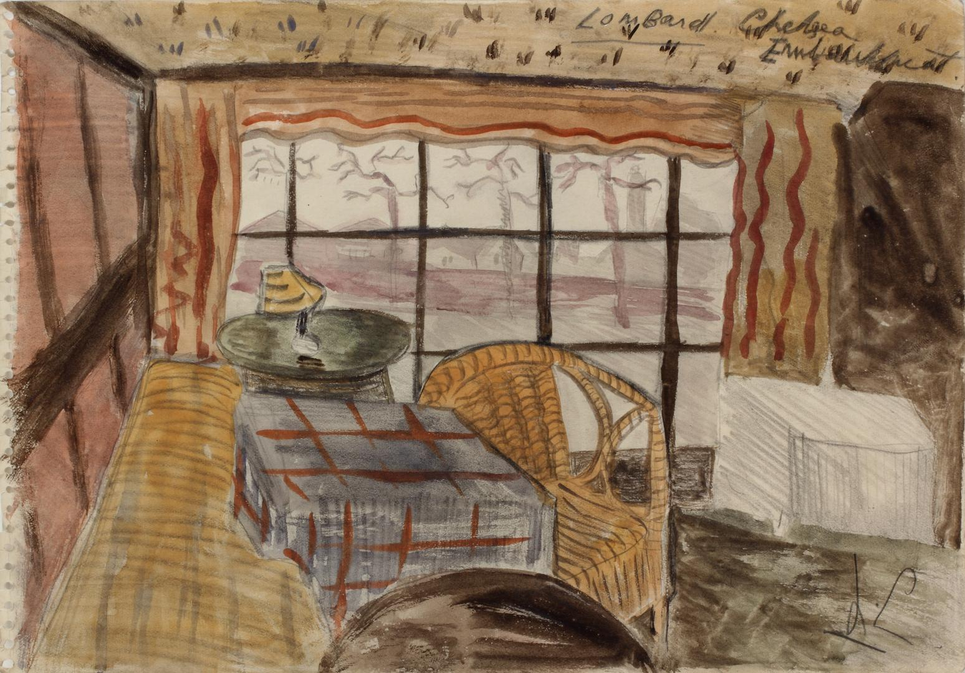
Leonora
Carrington
Mexico

Slide 23
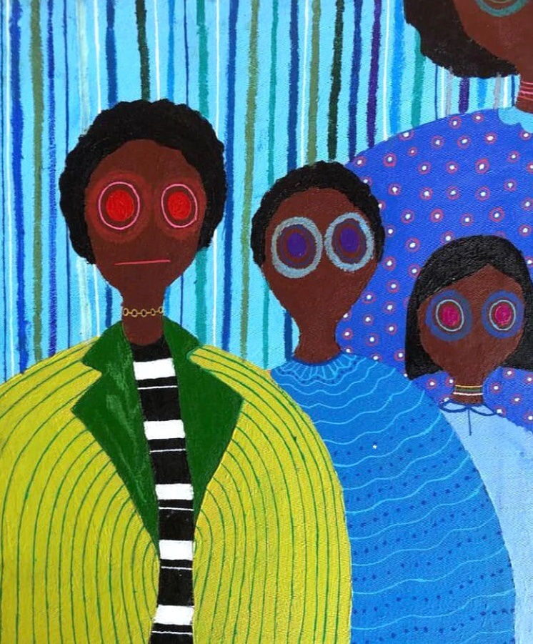
Kenya
Oruko

Slide 24
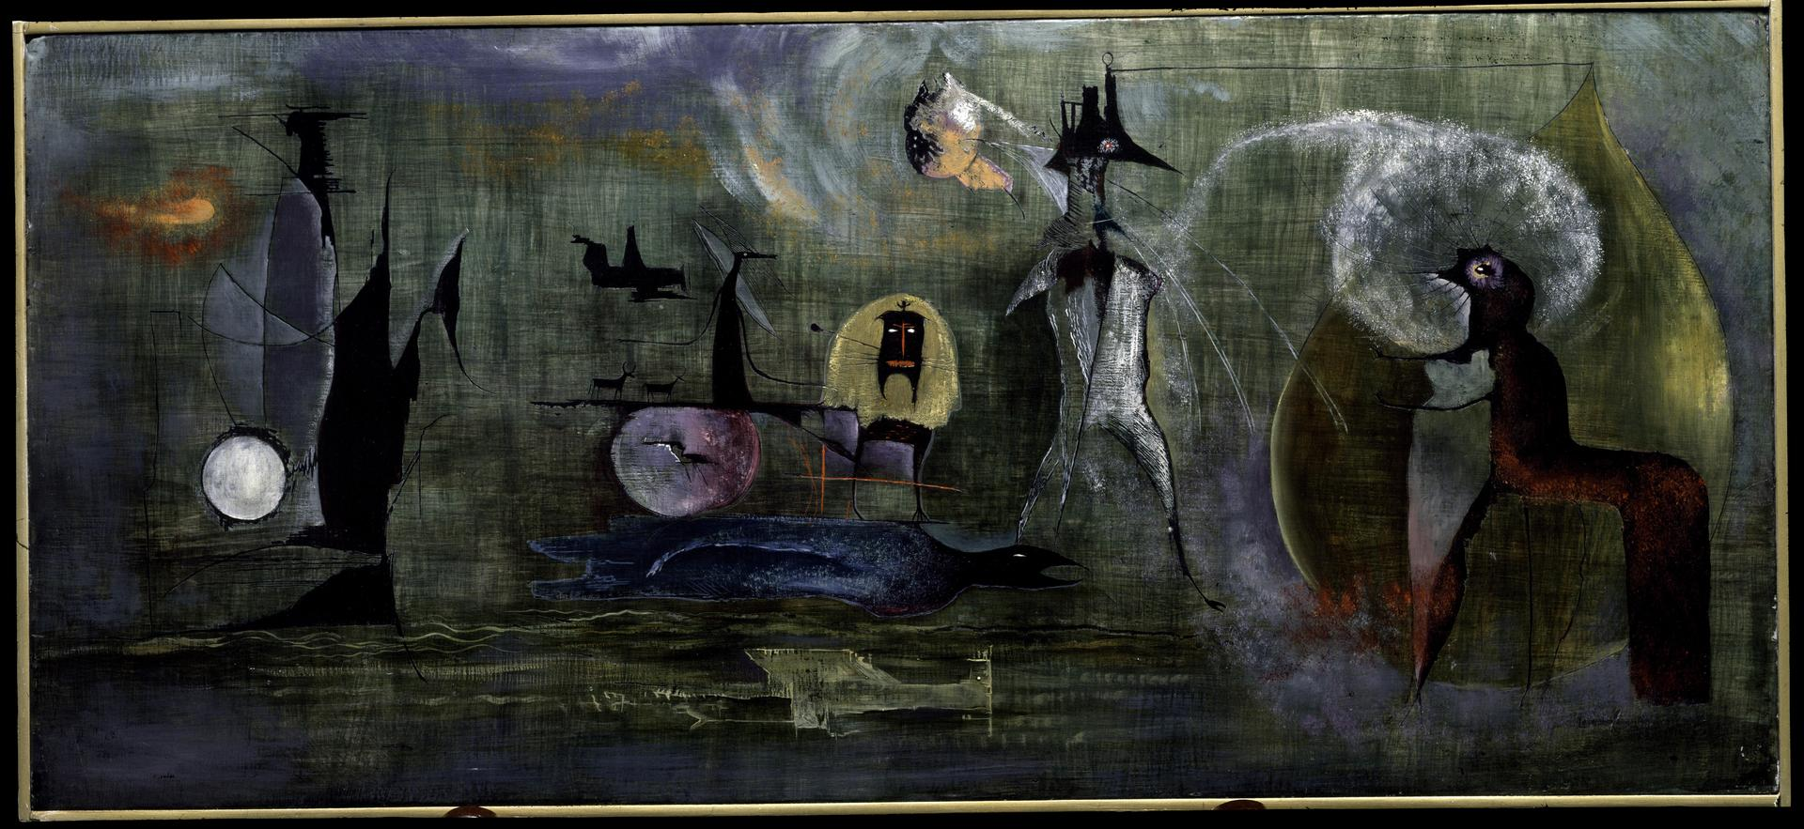
Leonora Carrington Mexico

Slide 25
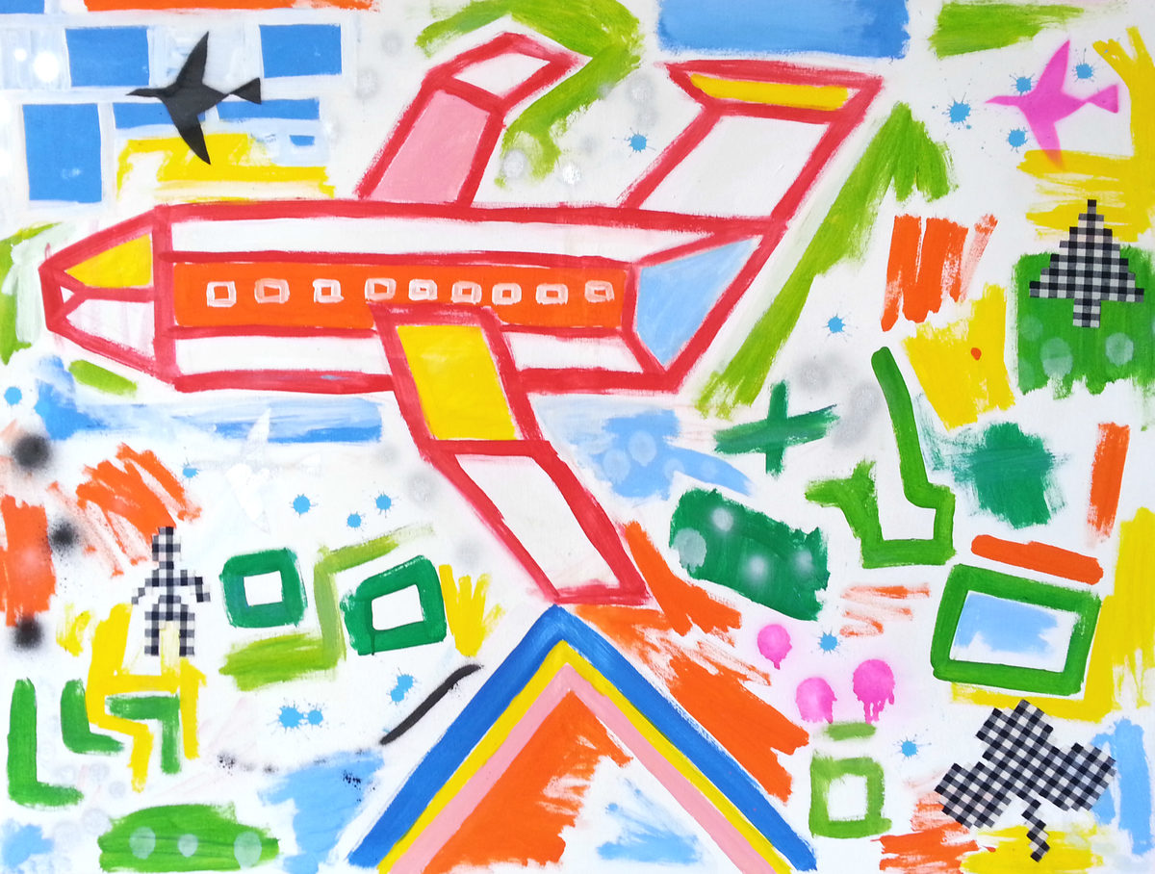
Hugo
Perez
Guatemala

